Slide 1



Spotify
Kmeans Algo_ Clustering Songs
Group2
Aabdual, Jacqueline, Radka ,Yan
0:23
-3:25

Slide 2
Group 2
Keep only 4 features
Data Preparation
Modelling
By human interpretation what is relevant.
Cluster Exploration
01
energy
02
tempo
Summary
03
acousticness
04
loudness

Slide 3
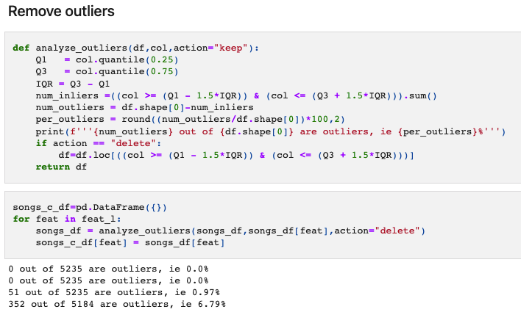
Group 2
Remove Outliers
Data Preparation
Modelling
K-means algorithm is sensitive to outliers
Cluster Exploration
Summary

Slide 4
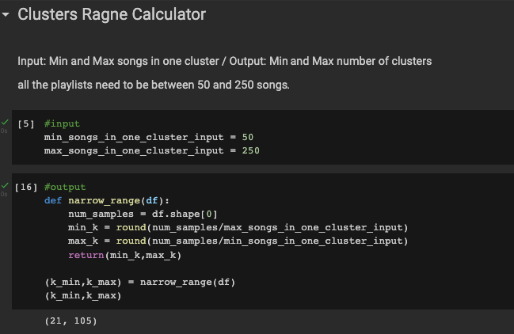
Group 2
Narrow Down the Range of K-Means based on Business Requirements
Data Preparation
Modelling
Cluster Exploration
Summary
For practicality, the upper border has been shrunk to 50

Slide 5
Group 2
Data Preparation
Modelling
Decide to Use StandardScaler
Cluster Exploration
Summary
industry’s go-to algorithm

Slide 6
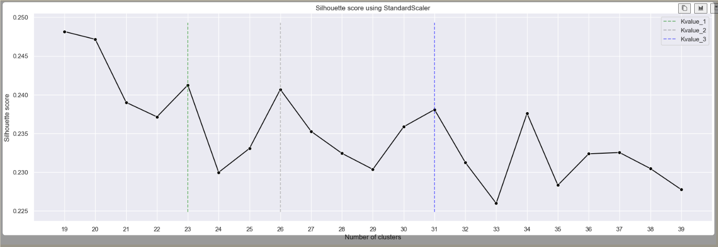
Group 2
Silhouette Score (20>KMeans>50)
Data Preparation
Find three peak points (k=23, 26, 31) have biggest Silhouette Score (aka most separate distances)
Modelling
Cluster Exploration
Summary

Slide 7
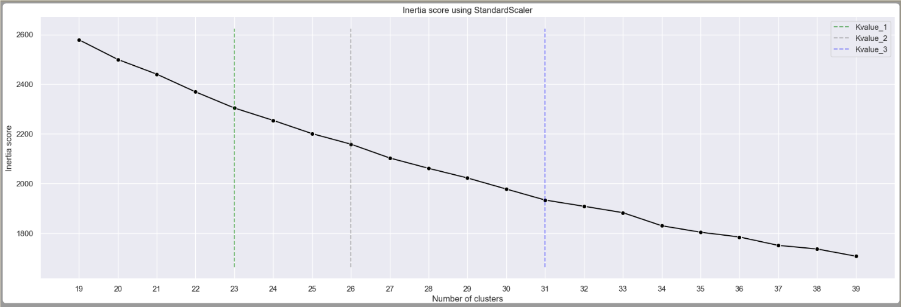
Group 2
Inertia Score (20>KMeans>50)
Data Preparation
For the same 3 values, 31 looks like the one with some “elbow shape”
Modelling
Cluster Exploration
Summary

Slide 8
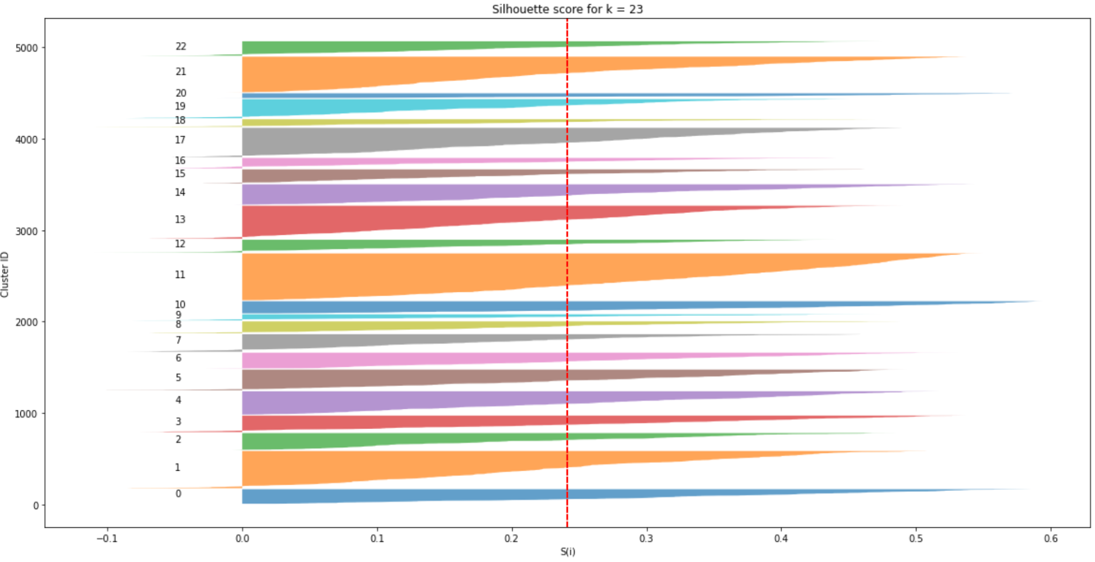
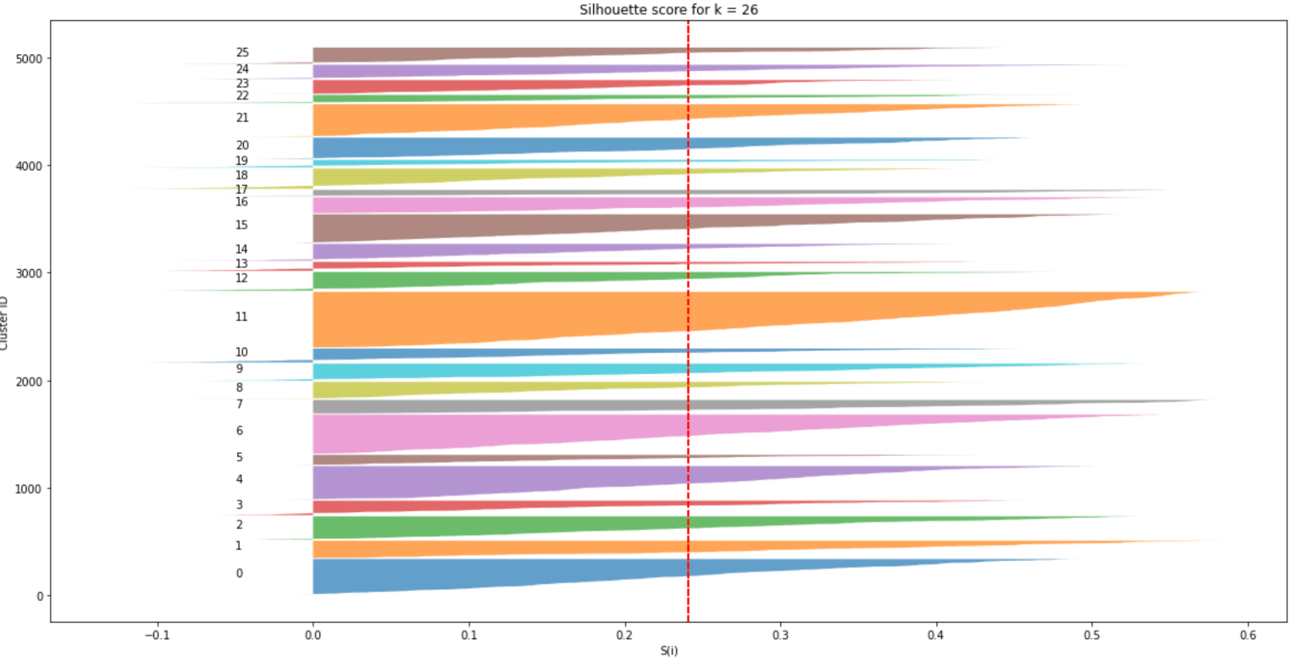
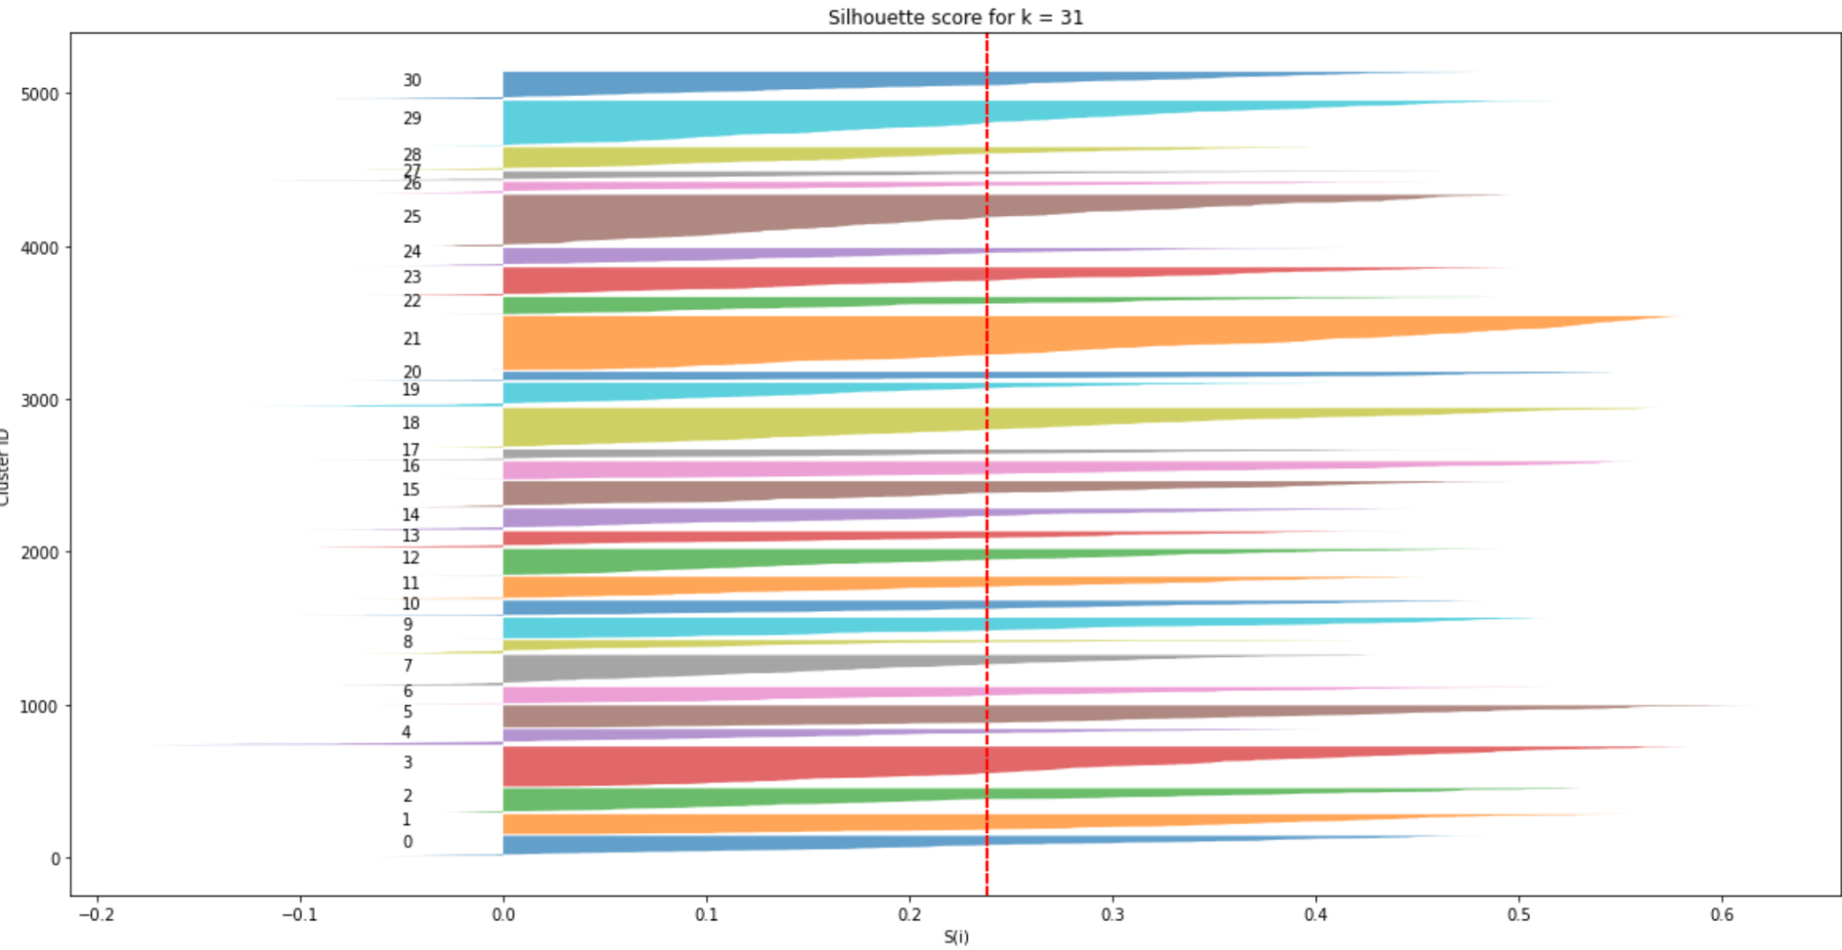
Group 2
Silhouette Score (20>KMeans>35)
Data Preparation
Focus on the discovery of k=23, 26, 31
Modelling
k= 23
k= 26
Cluster Exploration
Summary
k= 31
Found Out 31 is the right number of clusters to go

Slide 9
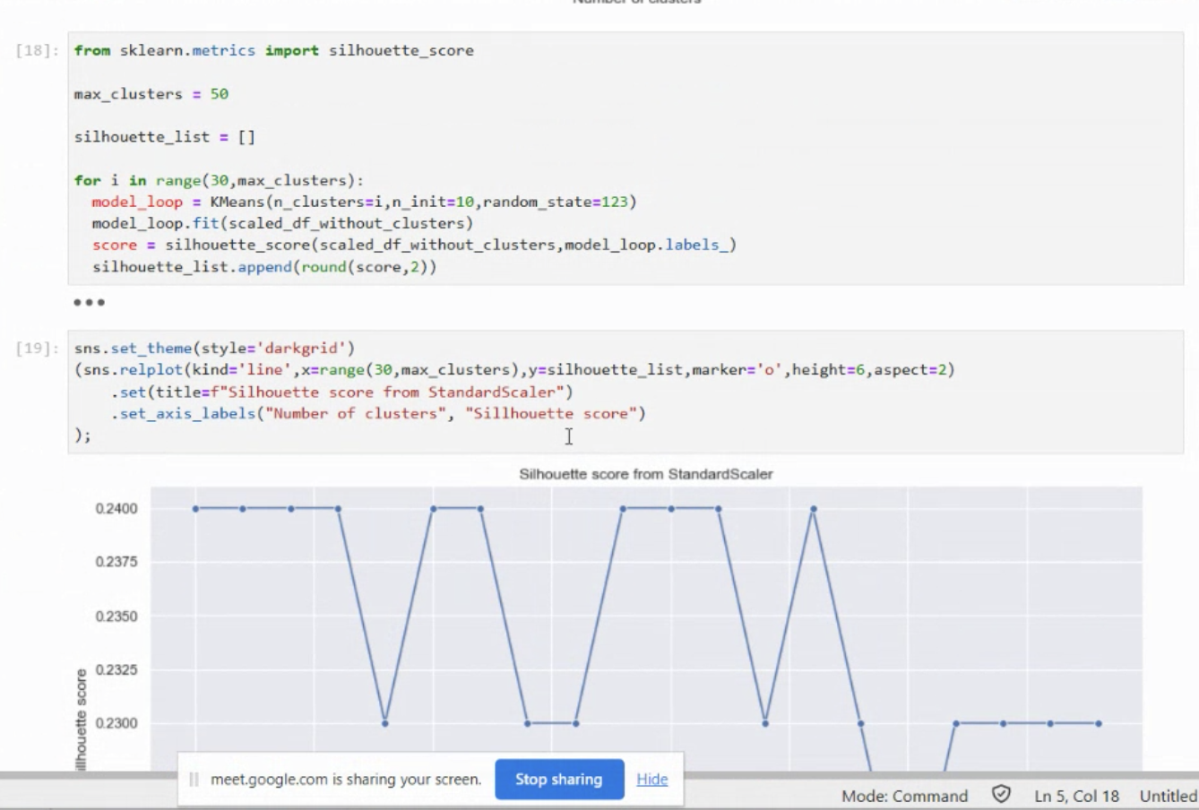
Group 2
Silhouette Score (rounding)
Data Preparation
Silhouette is sensitive to decimals. We rounded up to 5 decimal places.
Modelling
Cluster Exploration
Summary

Slide 10
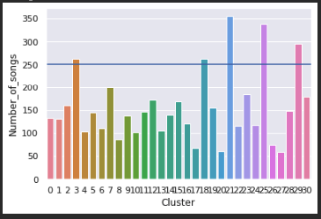
Group 2
Explore our 31 clusters
Data Preparation
Some clusters are exceeded our desire threshold (250 songs /cluster)
Filter with shortest distance to centroid
Modelling
Cluster Exploration
Summary

Slide 11
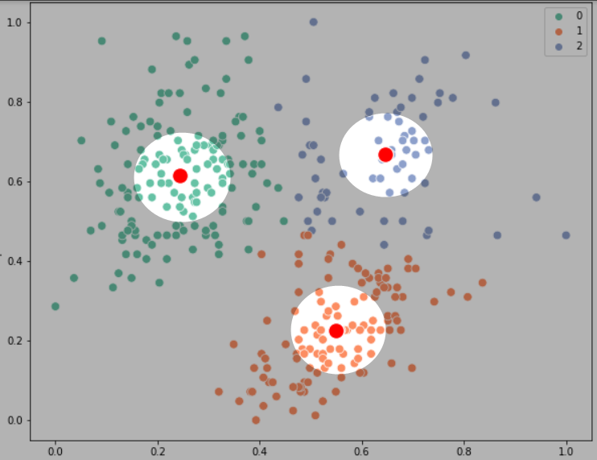
Group 2
Is K-Means a good method to create playlists
Data Preparation
Use first elbow Value K= 9-10.
Consider n nearest songs to the centroid.
use human interpretation to create labeled Data
Use labeled Data and supervised Clustering to create playlists
Modelling
Cluster Exploration
Summary

Slide 12
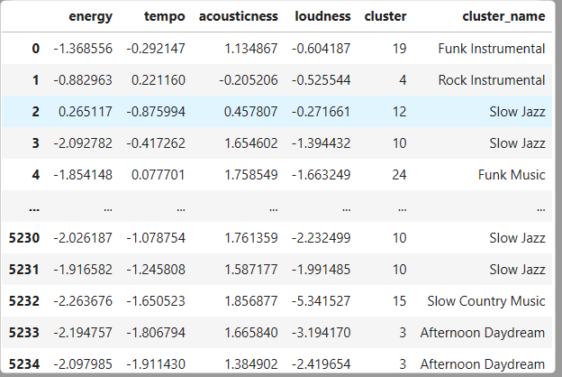
Group 2
Are Spotify’s audio features able to identify “similar songs”, as defined by human?
Data Preparation
Classification was able to detect the speed and tempo of the song.
But some important features are missing ( ex. Language , Lyrics interpretation)
Modelling
Cluster Exploration
Summary

Slide 13
Thank You

